Slide 1
UNIT-6
Advanced Behavioral Modeling

Slide 2
Ch-20 Events and Signals
Events:
An event is the specification of a significant occurrence that has a location in time and space.
In the context of state machines, an event is an occurrence of a stimulus that can trigger a state transition.
An event may be internal or external.
External events are those that pass between the system and the actors.
  Pushing of a button
  Interrupt from a collision sensor

Slide 3
Internal events are those that pass among the objects that live inside the system.
An overflow exception.
Four Types: Signals, calls, the passing of time, and change in state.

Slide 4
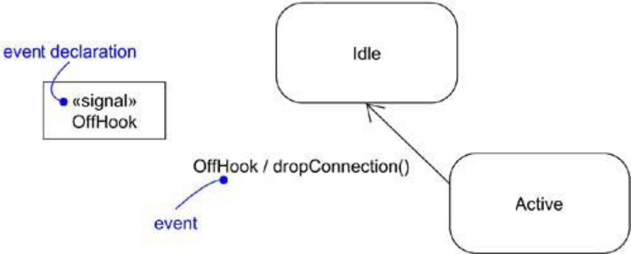
Figure : Events

Slide 5
Signals:
A signal is a kind of event that represents the specification of an asynchronous stimulus communicated between instances.
A signal represents a named object that is dispatched (thrown) asynchronously by one object and then received (caught) by another.
Exceptions are the most common kind of internal signals

Slide 6
Signals have a lot in common with classes.
  They may have instances.They may enter into generalization relationships.
  May have attributes and operations.
  May be sent as an action of a state transition in a state machine or the sending of a message in as interaction.
  Operations can send signals ( e.g., exceptions)

Slide 7
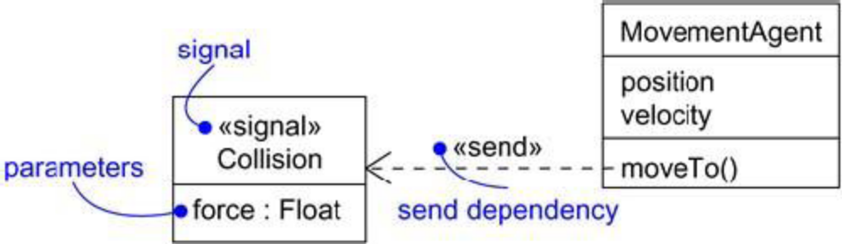
Figure : Signals

Slide 8
Call Events:
A call event represents the dispatch of an operation.
A call event is synchronous. This means that the control is transferred from the sender to the receiver.
The operation is completed.
The receiver moves to a new state, and control returns to the sender.
In UML a call event is not distinguished from a signal.

Slide 9
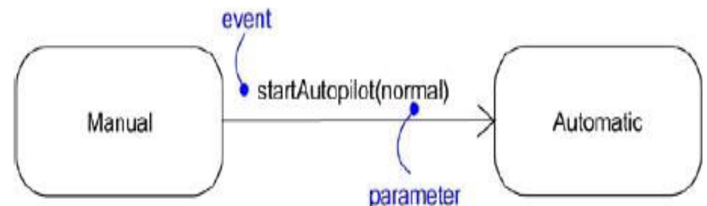
Figure : Call Events

Slide 10
Time and Change Events
A time event is an event that represents the passage of time. As shown in the figure , time event by using the keyword after followed by some expression that evaluates to a period of time.
A change event is an event that represents a change in state or the satisfaction of some condition. As shown in the figure, a change event by using the keyword when followed by some Boolean expression.

Slide 11
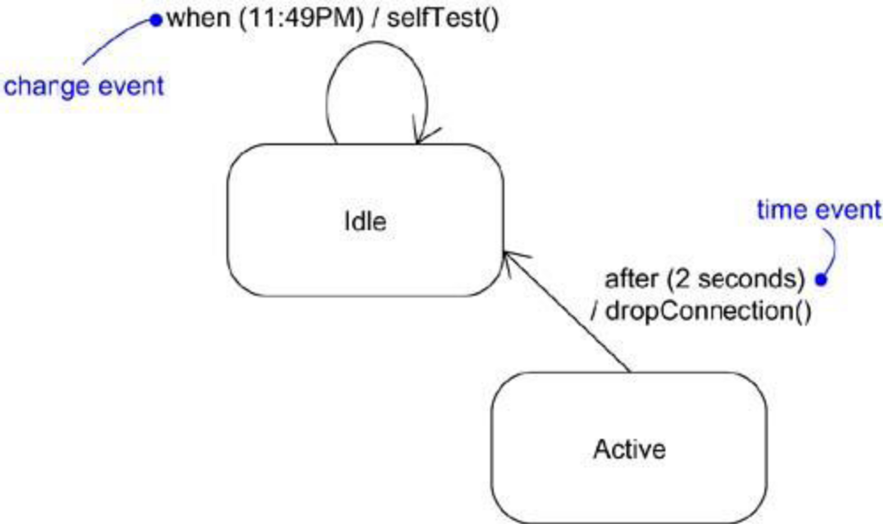
Figure : Time and Change Events

Slide 12
Common Modeling Techniques:
To model a family of signals:-
Consider all the different kinds of signals to which a given set of active objects may respond.
Look for the common kinds of signals and place them in a generalization/specialization hierarchy using inheritance. Elevate more general ones and lower more specialized ones.
Look for the opportunity for polymorphism in the state machines of these active objects. Where you find polymorphism, adjust the hierarchy as necessary by introducing intermediate abstract signals.

Slide 13
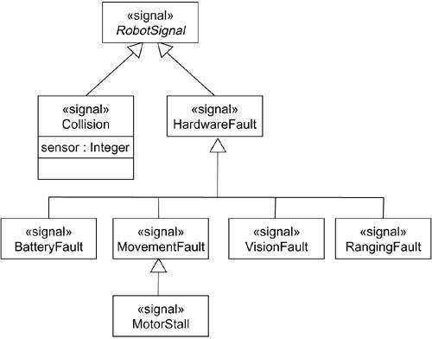
Modeling Families of Signals

Slide 14
To model exceptions:-
For each class and interface, and for each operation of such elements, consider the exceptional conditions that may be raised.
Arrange these exceptions in a hierarchy. Elevate general ones, lower specialized ones, and introduce intermediate exceptions, as necessary.
For each operation, specify the exceptions that it may raise. You can do so explicitly (by showing send dependencies from an operation to its exceptions) or you can put this in the operation's specification.

Slide 15
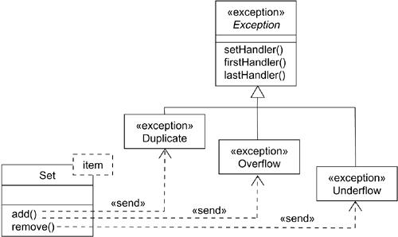
Modeling Exceptions

Slide 16
Ch- 21 State Machines
A state machine is a behavior that specifies the sequences of states an object goes through during its lifetime in response to events.
A state is a condition or situation during the life of an object during which it satisfies some condition, performs some activity.
An event is the specification of a significant occurrence that has a location in time and space.

Slide 17
A transition is a relationship between two states indicating that an object in the first state will perform certain actions and enter the second state when a specified event occurs and specified conditions are satisfied.
An activity is ongoing nonatomic execution within a state machine.
An action is an executable atomic computation that results in a change in state of the model or the return of a value.

Slide 18
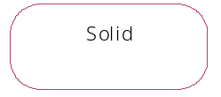
Graphically, a state is rendered as a rectangle with rounded corners.
A transition is rendered as a solid directed line.

Slide 19
States:
A state is a condition or situation during the life of an object during which it satisfies some condition, performs some activity, or waits for some event. An object remains in a state for a finite amount of time.
A state has several parts.
1. Name: A textual string that distinguishes the state from other states; a state may be anonymous, meaning that it has no name
2. Entry/exit actions: Actions executed on entering and exiting the state, respectively
3. Internal transitions: Transitions that are handled without causing a change in state
4. Substates :The nested structure of a state, involving disjoint (sequentially active) or concurrent (concurrently active) substates
5. Deferred events: A list of events that are not handled in that state but, rather, are postponed and queued for handling by the object in another state

Slide 20
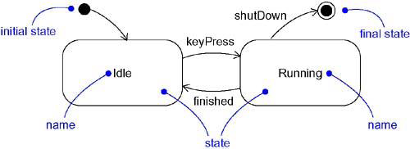
States

Slide 21

Initial and Final States
Initial state indicates the starting place for the state machine or substate. An initial state is represented as a filled black circle.
Final state indicates that the execution of the state machine (or the enclosing state) has been completed. A final state is represented as a filled black circle surrounded by an unfilled circle (Bull’s eye notation).

Slide 22
Transitions:
A transition is a relationship between two states indicating that an object in the first state will perform certain actions and enter the second state when a specified event occurs and specified conditions are satisfied. On such a change of state, the transition fires. Until the transition fires, the object is said to be in the source state; after it fires, it is said to be in the target state.

Slide 23
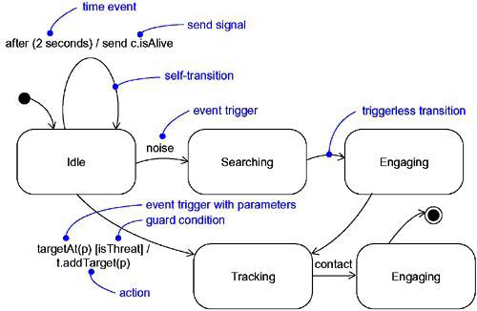
Transitions

Slide 24
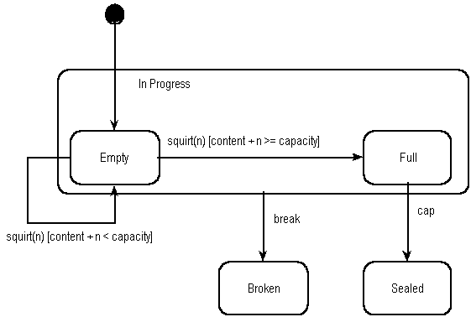
Filling water Bottle s

Slide 25
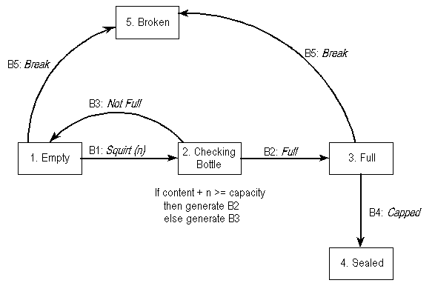
Statechart Diagram can be for single bottle or for the bottle filling plant

Slide 26
A transition has five parts.
Source state The state affected by the transition; if an object is in the source state, an outgoing transition may fire when the object receives the trigger event of the transition and if the guard condition, if any, is satisfied.
2. Event trigger The event whose reception by the object in the source state makes the transition eligible to fire, providing its guard condition is satisfied. (We can also have trigger less transitions (or) completion transitions).
3. Guard condition A Boolean expression that is evaluated when the transition is triggered by the reception of the event trigger; if the expression evaluates True, the transition fires; if False, the transition does not fire and the event is lost.
It is rendered as a Boolean expression enclosed in square brackets.

Slide 27
4. Action An executable atomic computation that may directly act on the object that owns the state machine, and indirectly on other objects that are visible to the object
5. Target state The state that is active after the completion of the transition. A transition is rendered as a solid directed line from the source to the target state. A self-transition is a transition whose source and target states are the same.

Slide 28
Advanced States and Transitions:
UML's state machines provides a no. of advanced features that help us to manage complex behavioral models.
These features often
  reduce the no. of states & transitions
  codify a number of common and complex idioms
Advanced features include: Entry and exit actions, internal transitions, activities, and deferred events.

Slide 29
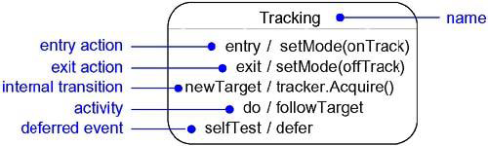
Advanced States and Transitions

Slide 30
Entry and Exit Actions
In the state symbol, we can include an entry action (marked by the keyword event entry) and an exit action (marked by the keyword event exit), together with an appropriate action.
Whenever we enter the state, its entry action is dispatched; whenever we leave the state, its exit action is dispatched.
Entry and exit actions may not have arguments or guard conditions.

Slide 31
Internal Transitions
Transitions handled without causing a change in state are called internal transitions.
Whenever we are in the state and that event is triggered, the corresponding action is dispatched without leaving and then reentering the state. Therefore, the event is handled without dispatching the state's exit and then entry actions.
Internal transitions may have events with parameters and guard conditions. Internal transitions are similar to interrupts.

Slide 32
Activities
While in a state, the object does some work that will continue until it is interrupted by an event.
We use “do” transition to specify the work that's to be done inside a state after the entry action is dispatched. The activity of a do transition might name another state machine..

Slide 33
Deferred Events
A deferred event is a list of events whose occurrence in the state is postponed.
Substates
A substate is a state that's nested inside another one.
A simple state is a state that has no substructure.
A state that has substates i.e, nested states is called a composite state. A composite state may be
  Sequential substates.
  Concurrent substates.

Slide 34
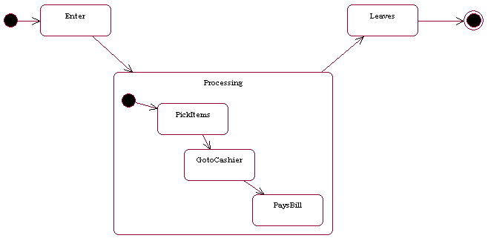
Sequential Substates

Slide 35
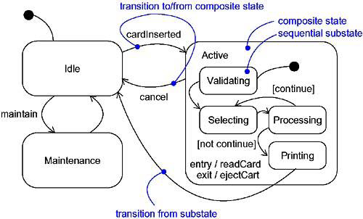

Slide 36
Sequential Substates
Using flat state machines, it's appears quite messy to include all the states. Sequential substates reduces the no. of states/transitions by giving a provision for substates.
Sequential substates partition the state space of the composite state into disjoint states.

Slide 37
History States
History state is the state that remembers the last substate that was active prior to leaving the composite state.
History states are used, if we want a transition to activate the last substate.
Show a transition from outside the composite state directly to the history state. The first time we enter a composite state, it has no history.

Slide 38
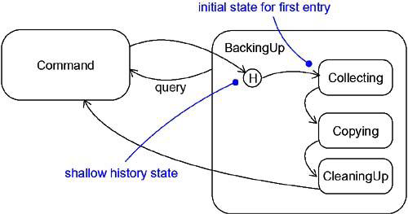
History State

Slide 39
History states are of 2 types:
  Shallow History state (H)
  Deep History state (H*)
Shallow history state is denoted by H, which remembers only the history of the immediate nested state machine.
Deep history state is denoted by H*, which remembers down to the innermost nested state at any depth.

Slide 40
If we have only one level of nesting, shallow and deep history states are semantically similar.
If we have more than one level of nesting, shallow history remembers only the outermost nested state; deep history remembers the innermost nested state at any depth.

Slide 41
Concurrent Substates (similar to Fork & join):
Sequential substates are the most common kind of nested state machine. In certain modeling situations, however, you'll want to specify concurrent substates.
These substates let you specify two or more state machines that execute in parallel in the context of the enclosing object.

Slide 42
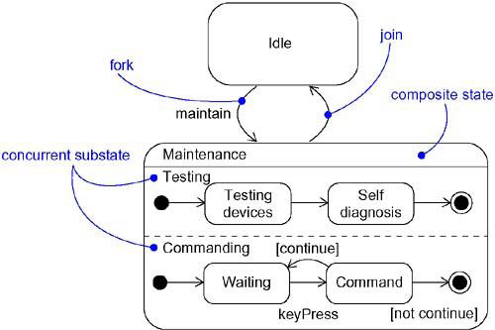
Concurrent Substates

Slide 43
Ch-22 Processes and Threads
In the UML, each independent flow of control is modeled as an active object.
An active object is a process or thread that can initiate control activity.
An active object is an object that owns a process or thread and can initiate control activity. An active class is a class whose instances are active objects.
A process is a heavyweight flow that can execute concurrently with other processes.
A thread is a lightweight flow that can execute concurrently with other threads within the same process.

Slide 44
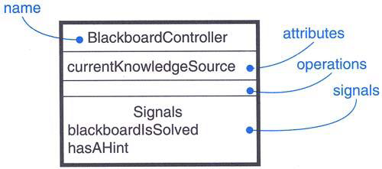
Graphically, an active class is rendered as a rectangle with thick lines. Processes and threads are rendered as stereotyped active classes.
Active Class

Slide 45
Classes and Events
Active classes are just classes, albeit ones with a very special property.
An active class represents an independent flow of control, whereas a plain class embodies no such flow.
In contrast to active classes, plain classes are implicitly called passive because they cannot independently initiate control activity.

Slide 46
Active classes may have instances. Active classes may have attributes and operations and may participate in dependency, generalization, and association (including aggregation) relationships.
Active classes may use any of the UML's extensibility mechanisms, including stereotypes, tagged values, and constraints.
Active classes may be the realization of interfaces. Active classes may be realized by collaborations, and the behavior of an active class may be specified by using state machines.

Slide 47
All of the UML's extensibility mechanisms apply to active classes. Most often, you'll use tagged values to extend active class properties, such as specifying the scheduling policy of the active class.
The UML defines two standard stereotypes that apply to active classes.
1. process: Specifies a heavyweight flow that can execute concurrently with other processes.
2. thread: Specifies a lightweight flow that can execute concurrently with other threads within the same process.

Slide 48
The distinction between a process and a thread arises from the two different ways a flow of control may be managed by the operating system of the node on which the object resides.
A process is heavyweight, which means that it is a thing known to the operating system itself and runs in an independent address space.
Processes are never nested inside one another. If the node has multiple processors, then true concurrency on that node is possible. If the node has only one processor, there is only the illusion of true concurrency, carried out by the underlying operating system.

Slide 49
A thread is lightweight. It may be known to the operating system itself. More often, it is hidden inside a heavier-weight process and runs inside the address space of the enclosing process.
Threads are never nested inside one another. In general, there is only the illusion of true concurrency among threads because it is processes, not threads, that are scheduled by a node's operating system.

Slide 50
Synchronization
There are three alternatives to this approach, each of which involves attaching certain synchronization properties to the operations defined in a class.
1. Sequential: Callers must coordinate outside the object so that only one flow is in the object at a time. In the presence of multiple flows of control, the semantics and integrity of the object cannot be guaranteed.
2. Guarded: The semantics and integrity of the object is guaranteed in the presence of multiple flows of control by sequential zing all calls to all of the object's guarded operations. In effect, exactly one operation at a time can be invoked on the object, reducing this to sequential semantics.

Slide 51
3. Concurrent: The semantics and integrity of the object is guaranteed in the presence of multiple flows of control by treating the operation as atomic.

Slide 52
Ch-23 Time and Space
A timing mark is a denotation for the time at which an event occurs.
A time expression is an expression that evaluates to an absolute or relative value of time.
A timing constraint is a semantic statement about the relative or absolute value of time.
Graphically, a timing constraint is rendered as for any constraint- that is, a string enclosed by brackets and generally connected to an element by a dependency relationship.
Location is the placement of a component on a node.
Graphically, location is rendered as a tagged value- that is, a string enclosed by brackets and placed below an element's name, or as the nesting of components inside nodes.

Slide 53
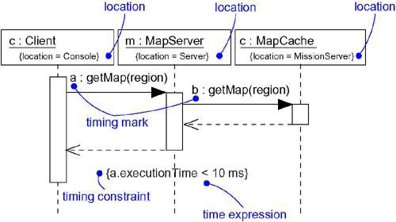
Timing Constraints and Location

Slide 54
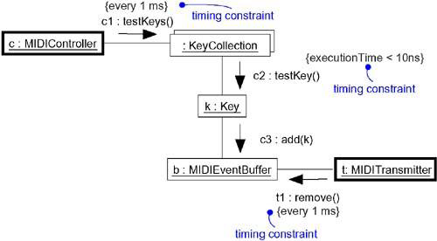
Time:
Real time systems are, by their very name, time-critical systems. Events may happen at regular or irregular times; the response to an event must happen at predictable absolute times or at predictable times relative to the event itself.

Slide 55
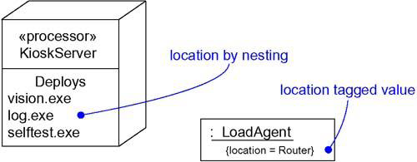
Location:
Distributed systems, by their nature, encompass components that are physically scattered among the nodes of a system. For many systems, components are fixed in place at the time they are loaded on the system; in other systems, components may migrate from node to node.

Slide 56
Ch-24 Statechart Diagrams
Statechart diagrams are one of the five diagrams in the UML for modeling the dynamic aspects of systems.
A statechart diagram shows a state machine.
An activity diagram is a special case of a statechart diagram in which all or most of the states are activity states and all or most of the transitions are triggered by completion of activities in the source state.
Thus, both activity and statechart diagrams are useful in modeling the lifetime of an object.
An activity diagram shows flow of control from activity to activity, a statechart diagram shows flow of control from state to state.

Slide 57
Statechart diagrams are not only important for modeling the dynamic aspects of a system, but also for constructing executable systems through forward and reverse engineering.
A statechart diagram shows a state machine, emphasizing the flow of control from state to state.
A state machine is a behavior that specifies the sequences of states an object goes through during its lifetime in response to events, together with its responses to those events.

Slide 58
A state is a condition or situation in the life of an object during which it satisfies some condition, performs some activity, or waits for some event.
An event is the specification of a significant occurrence that has a location in time and space. In the context of state machines, an event is an occurrence of a stimulus that can trigger a state transition.

Slide 59
A transition is a relationship between two states indicating that an object in the first state will perform certain actions and enter the second state when a specified event occurs and specified conditions are satisfied.
An activity is ongoing nonatomic execution within a state machine.
An action is an executable atomic computation that results in a change in state of the model or the return of a value.

Slide 60
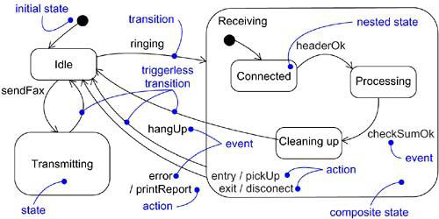
Graphically, a statechart diagram is a collection of vertices and arcs.
Statechart Diagram

Slide 61
Statechart diagrams commonly contain
  Simple states and composite states
  Transitions, including events and actions
A statechart diagram may contain conditions (branches), concurrent substates (forks & joins), action states, activity states, objects, initial states, final states, history states, and so on.
Common Uses
We use statechart diagrams to model the dynamic aspects of a system. These dynamic aspects may involve the event-ordered behavior an object.
When we model the dynamic aspects of a system, a class, or a use case, we'll typically use statechart diagrams in one way.

Slide 62
To model reactive objects
A reactive (or) event-driven object is typically idle until it receives an event. When it receives an event, its response usually depends on previous events. After the object responds to an event, it becomes idle again, waiting for the next event. For these kinds of objects, we'll focus on the stable states of that object, the events that trigger a transition from state to state, and the actions that occur on each state change.

